Slide 1
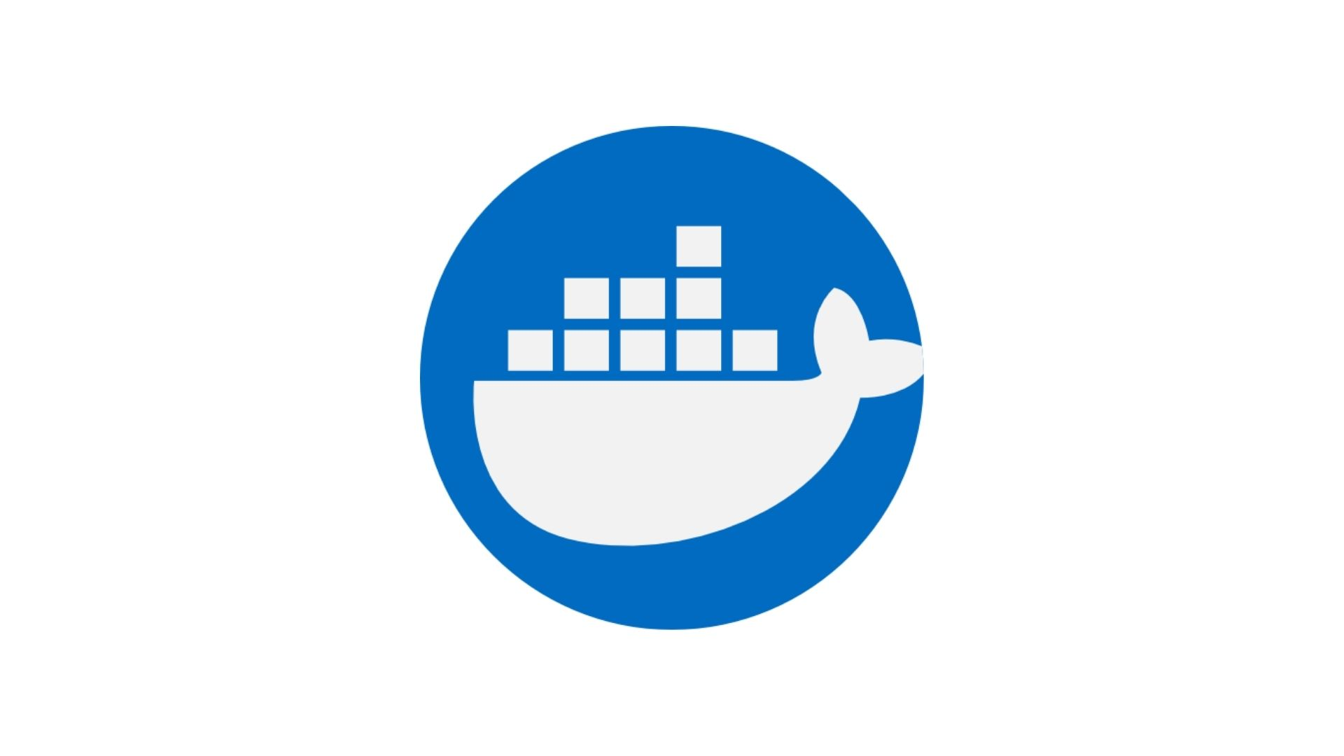
Containerization of YOLOv8-L Inference With SAHI
Using Docker
21/07/2023

Slide 2
Agenda
Introduction To Docker
Installation
Getting Started
Testing YOLOv8
Running YOLOv8-L +SAHI Inference in Docker Container
Build a New Image with the Changes of the container
Push Image To Docker Hub

Slide 3
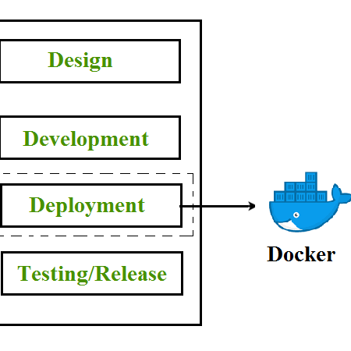
Introduction To Docker
Docker is the containerization platform that is used to package your application and all its dependencies together in the form of containers to make sure that your application works seamlessly in any environment which can be developed or tested or in production.

Slide 4
Installation
For Windows

Slide 5

Install Docker:
First, ensure that Docker is installed on your system. You can download and install Docker from the official Docker website: https://www.docker.com/get-started
Install the WSL 2 Update for Windows
Create a Docker Hub Account :
Create an Account in https://hub.docker.com

Slide 6
Getting Started
1.Create a Dockerfile
2.Build image out of Dockerfile
3.Run the image in the container

Slide 7
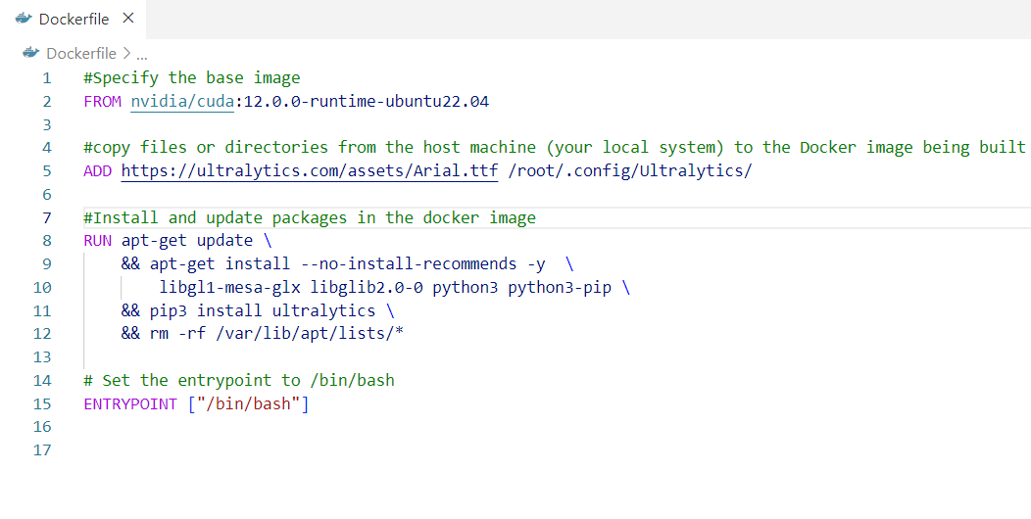
1. Create a Dockerfile
Create a file named "Dockerfile" (no file extension):
The Dockerfile defines the instructions for building the Docker image.

Slide 8

2. Build image out of Dockerfile
Open a terminal or command prompt, navigate to the directory containing the Dockerfile, and run the following command to build the Docker image

Slide 9
3. Run the image in the container
Once the image is built, you can run a Docker container from it using the following command:
Docker run –it your_image_name

Slide 10

Testing YOLOv8: Object Detection

Slide 11
Create directory to store input images and insert an image :
mkdir inputs
Run this command to perform object detection :
yolo predict model=yolov8l.pt source=inputs/test.jpg

Slide 12

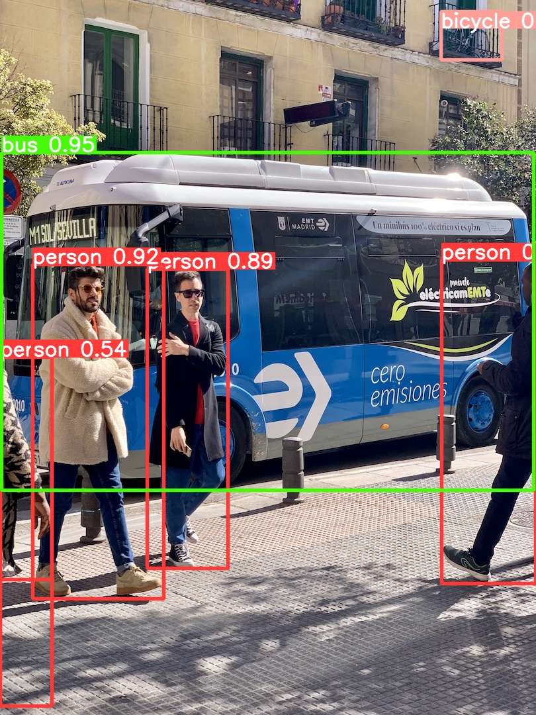
Results
Original Image Result Image of YOLOv8 Inference

Slide 13
Running Yolov8-L + SAHI Inference Inside The Docker Container
+ SAHI

Slide 14
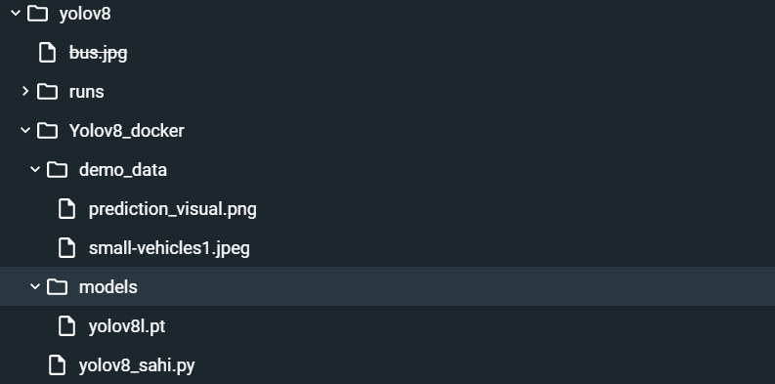
Inside the container’s files Import the code and files needed to run the inference :

Slide 15
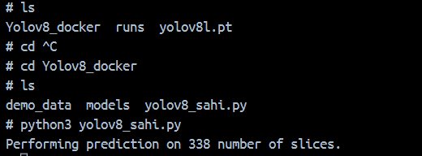
Open the terminal in the container to download SAHI and IPython to run the python script
pip install sahi
pip install ipython
Run the python file for inference

Slide 16
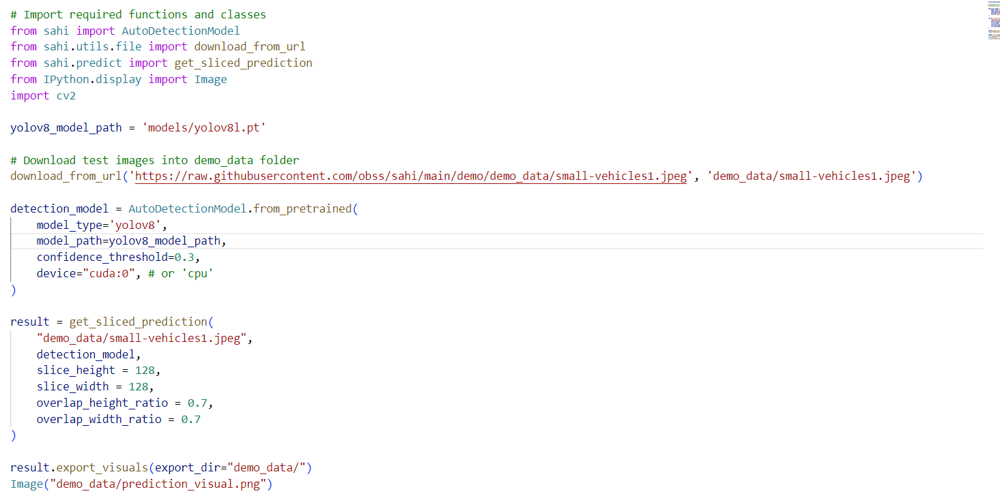
Python Script for the Inference :

Slide 17

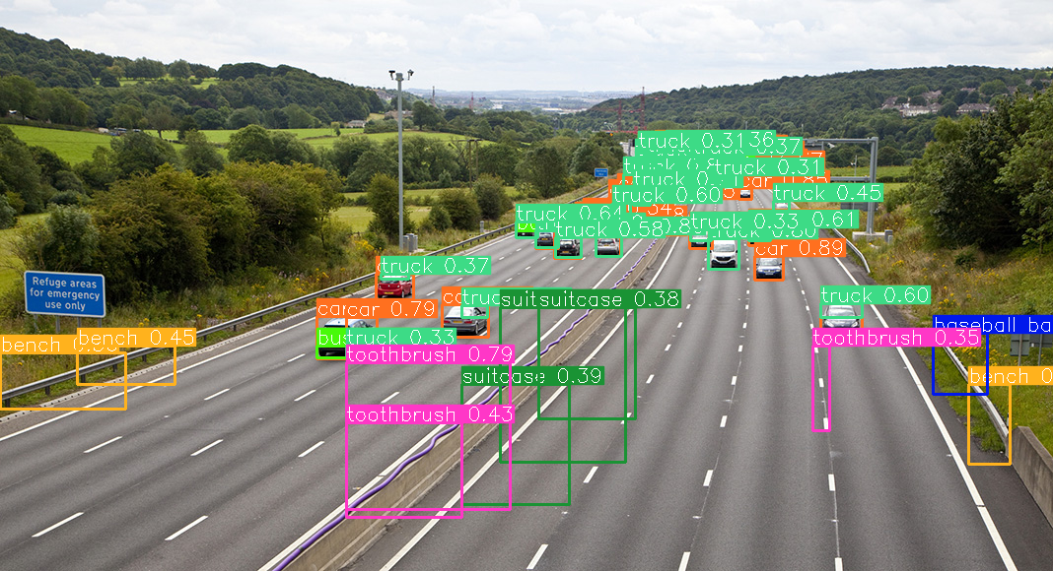
Once It’s done , you can view the result image /demo_data/prediction_visual.png

Slide 18
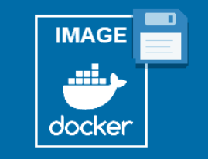
Build a Docker Image with The changes in The Container

Slide 19
To save the changes made in a container and create a new Docker image from those changes, you can use the docker commit command. The docker commit command creates a new image based on the current state of the container.
docker commit <CONTAINER_ID_OR_NAME> <NEW_IMAGE_NAME>:<TAG>

Slide 20
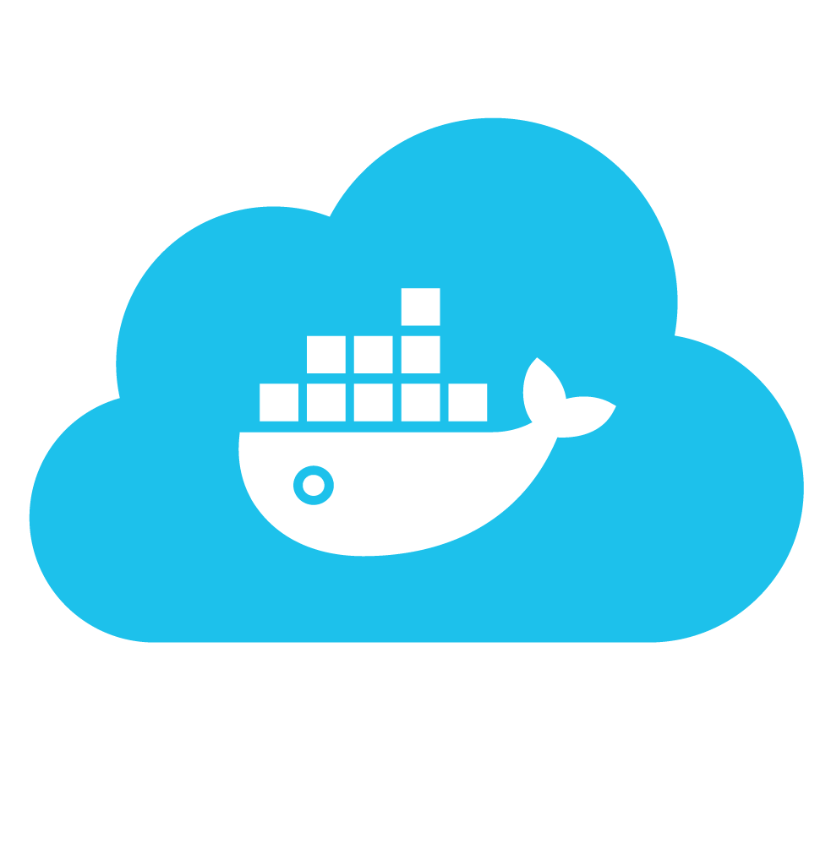
Push Image to Docker Hub

Slide 21
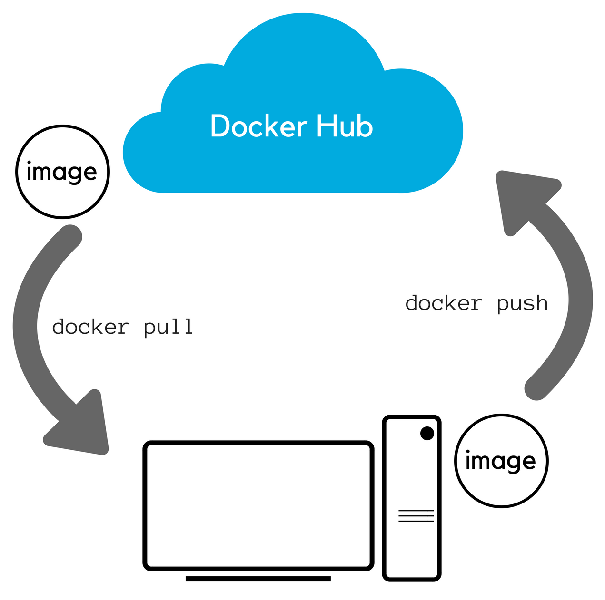
Concept Of Docker Hub

Slide 22
Tag the Docker image:
Before pushing the image, you need to tag it with your Docker Hub username/repository. Use the following command to tag the image:
docker tag your_image_name your_dockerhub_username/repository_name:tag
Log in to Docker Hub:
Open a terminal or command prompt and use the following command to log in to Docker Hub:
You will be prompted to enter your Docker Hub username and password.
docker login

Slide 23
Push the Docker image:
After logging in, you can push the Docker image to Docker Hub using the following command:
docker push your_dockerhub_username/repository_name:tag
Wait for the push to complete:
Docker will upload the image to Docker Hub. The time required will depend on the size of your image and your internet connection. You will see progress messages indicating the upload status.

Slide 24
Verify the image on Docker Hub:
Visit the Docker Hub website (https://hub.docker.com/) and log in with your Docker Hub account. You should see your repository listed with the pushed image and its tag.
6.Now your Docker image is successfully pushed to Docker Hub and can be accessed by others or deployed on other systems using the Docker pull command.
docker pull your_dockerhub_username/repository_name:tag

